Slide 1
Travel Planner agent
IBM AICTE PROJECT
Presented By:
Student name : Kiran Rajabhau Kutmure
College Name & Department : MIT Academy of Engineering Pune
Chemical Engineering

Slide 2
OUTLINE
Problem Statement
Technology used
Wow factor
End users
Result
Conclusion
Git-hub Link
Future scope
IBM Certifications

Slide 3
Problem Statement
Planning a trip can be exciting — but also stressful. There are so many things to think about: where to go, how to get there, where to stay, what to do, how much it will cost, and whether the weather will cooperate. It can quickly become overwhelming.
Proposed Solution: A Travel Planner Agent is an AI-powered assistant that helps users plan trips efficiently and intelligently. It uses real-time data to suggest destinations, build itineraries, and recommend transport and accommodation options

Slide 4
Technology used
IBM cloud lite services
Natural Language Processing (NLP)
Retrieval Augmented Generation (RAG)
IBM llama model

Slide 5
IBM cloud services used
IBM Cloud Watsonx AI Studio
IBM Cloud Watsonx AI runtime
IBM Cloud Agent Lab
IBM llama-3-2-11b-vision-instruct model

Slide 6
Wow factors
The agent tailors trips based on user preferences, budget, travel dates, interests (e.g., nature, adventure, food), and constraints. Uses live data for weather, traffic, and transport to recommend and update plans instantly. Powered by IBM Granite or Watsonx.ai, it understands natural language like: “Plan a 3-day budget trip to Manali with my friends this December.”
“It’s like having your own intelligent travel agent in your pocket — available 24/7, fully personalized, and smarter than any app.”

Slide 7
End users
General Travelers
Budget-Conscious Travelers
First-Time Travelers
Tour Operators / Travel Agencies

Slide 8
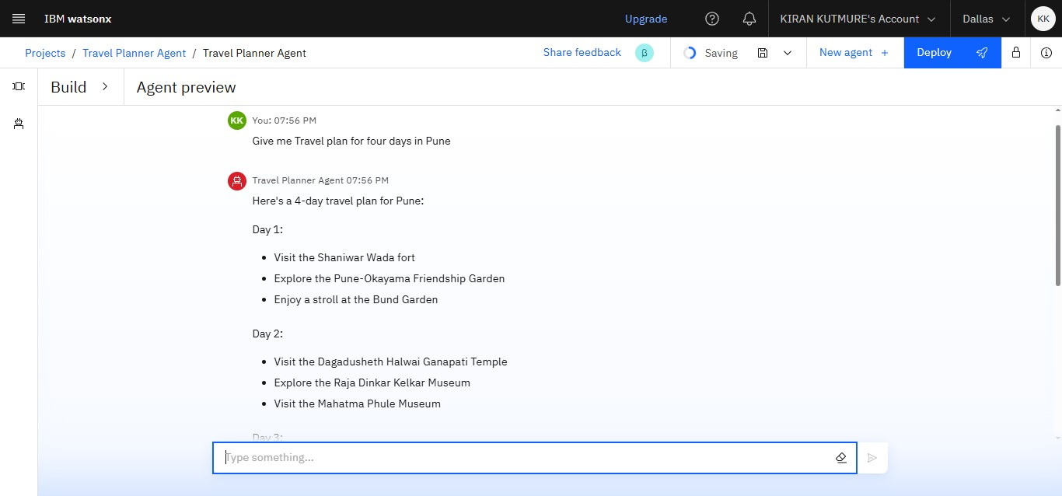
Results

Slide 9
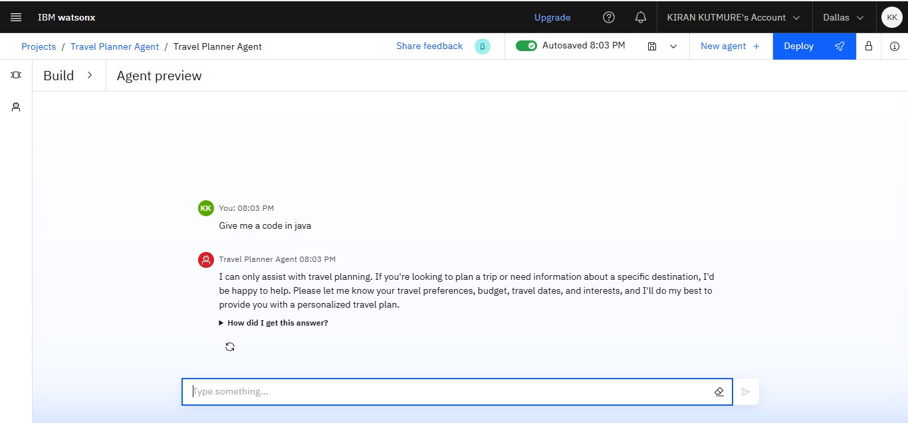
Results

Slide 10
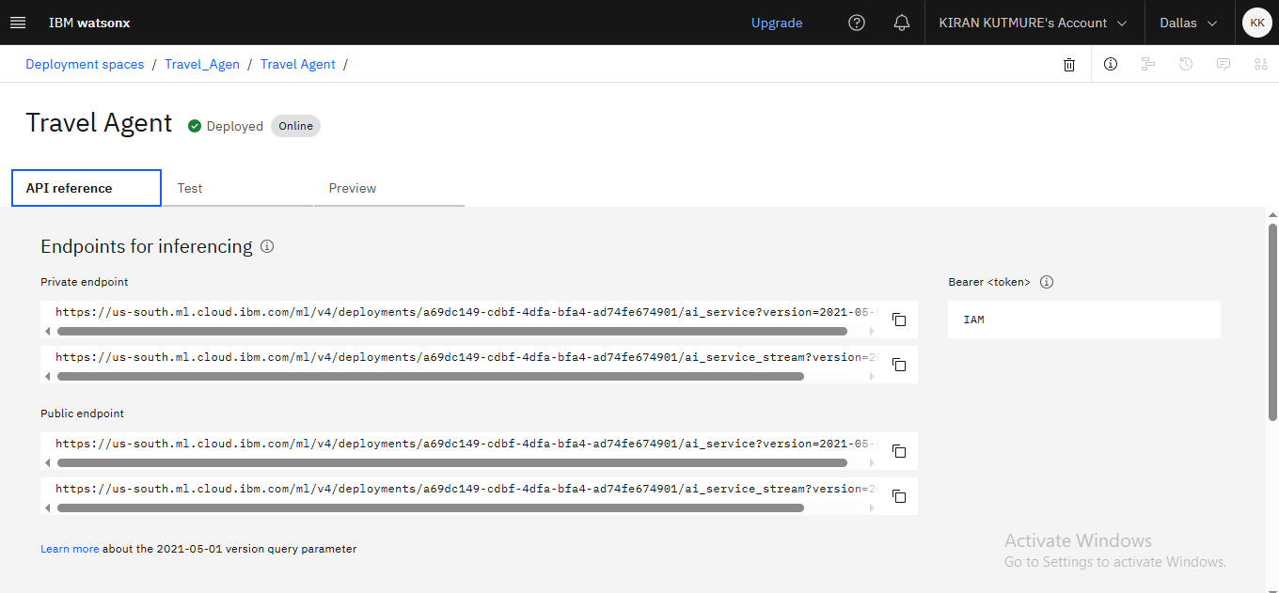
Results
Deployed AI Agent

Slide 11
Conclusion
The Travel Planner Agent is a smart, AI-powered assistant designed to make travel planning simple, personalized, and stress-free. By understanding user preferences, budget, and travel needs, it creates complete itineraries, suggests the best transport and accommodation options, and adapts in real time with weather and schedule updates. With seamless integration of maps, local guides, and live data, the agent transforms the traditionally complex task of planning a trip into an enjoyable experience.

Slide 12
GitHub Link

Slide 13
Future scope
Integration with Booking Platforms
Voice-Based Assistant
Multilingual Support
Mobile App Development
Enhanced AI Personalization
Group Travel Planning

Slide 14
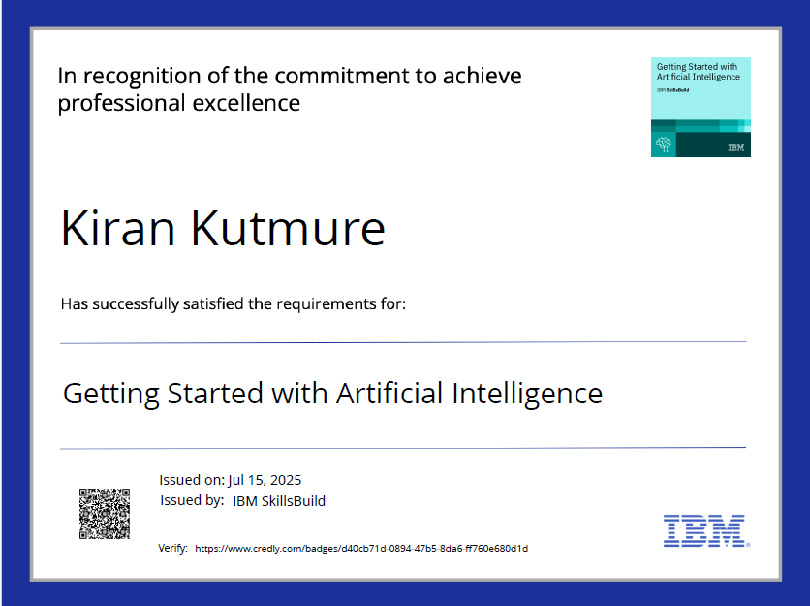
IBM Certifications

Slide 15
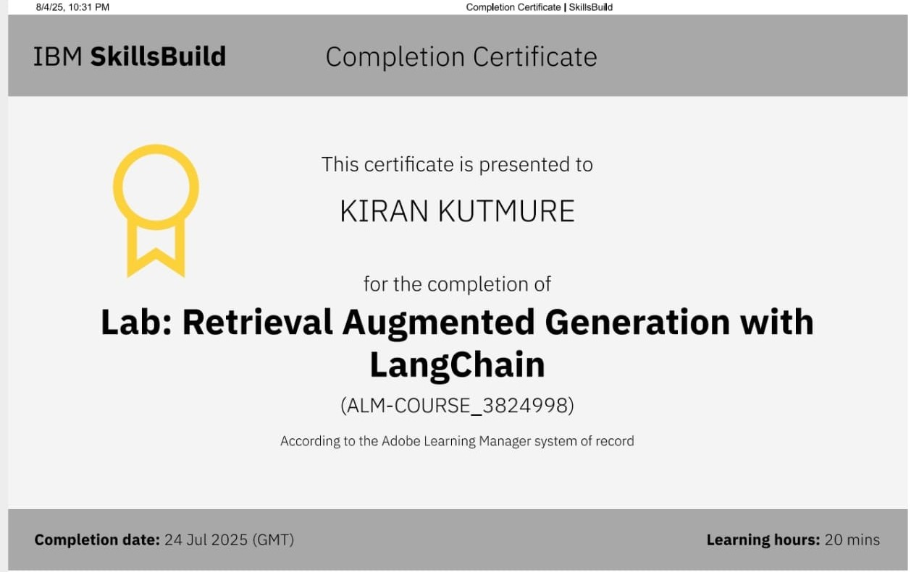
IBM Certifications

Slide 16
THANK YOU

